Slide 1
Optimizing trajectory for robot manipulator using PSO-based Inverse Kinematics
Presenter: Pham Minh Duc – TEEP Intern
Course: Evolutionary Computation
Teacher: Cheng Wei Peng

Slide 2
I. The problem of Inverse Kinematics
Multiple Solutions : High DoF arms are often kinematically redundant, meaning there are infinite joint configurations that can achieve the same end-effector pose.
Nonlinearity and Complexity: Forward Kinematics includes many trigonometric functions which can returns double solutions for each equation.
Singularities: High DoF manipulators can encounter kinematic singularities, where the Jacobian matrix loses rank and causes loss of movement in certain directions.
No constraint

Slide 3
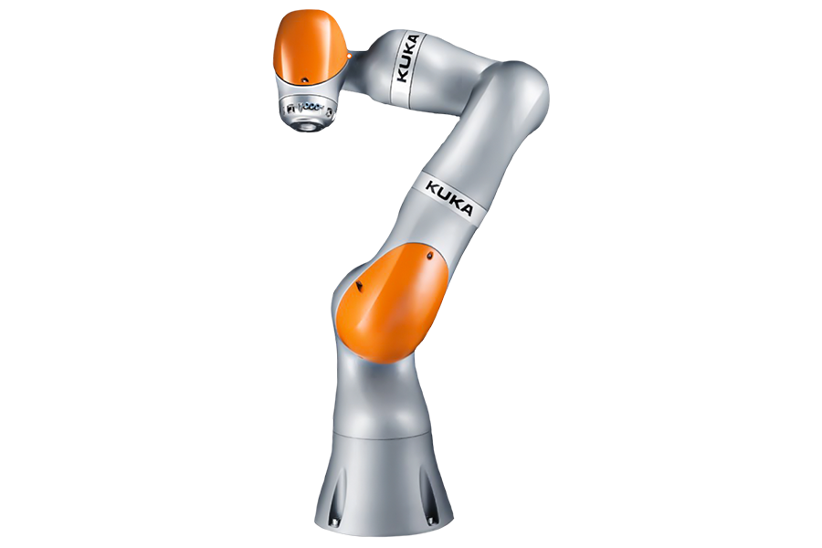
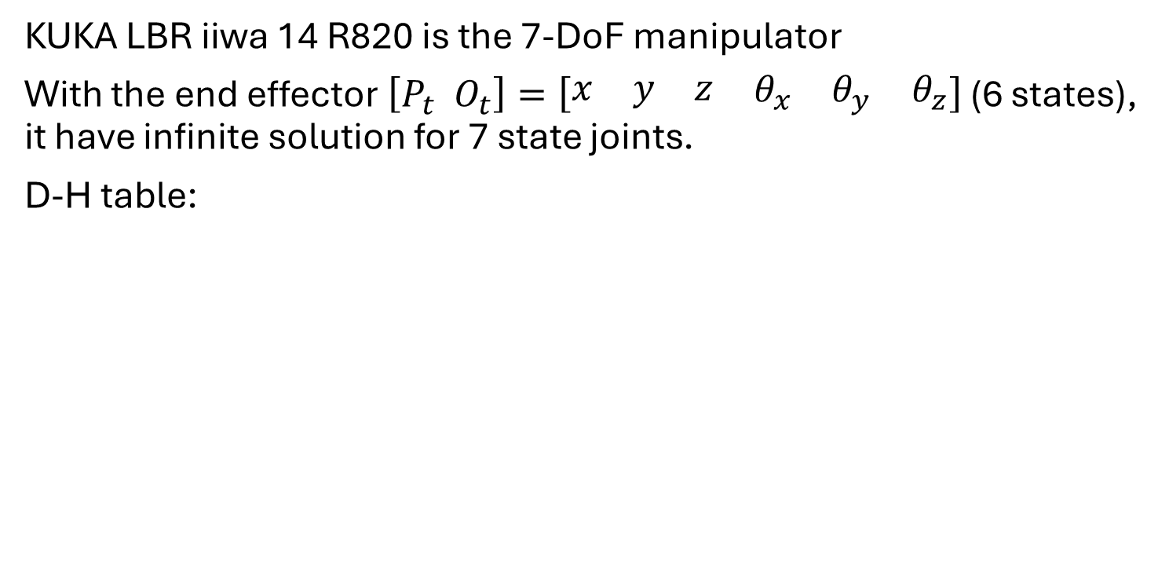
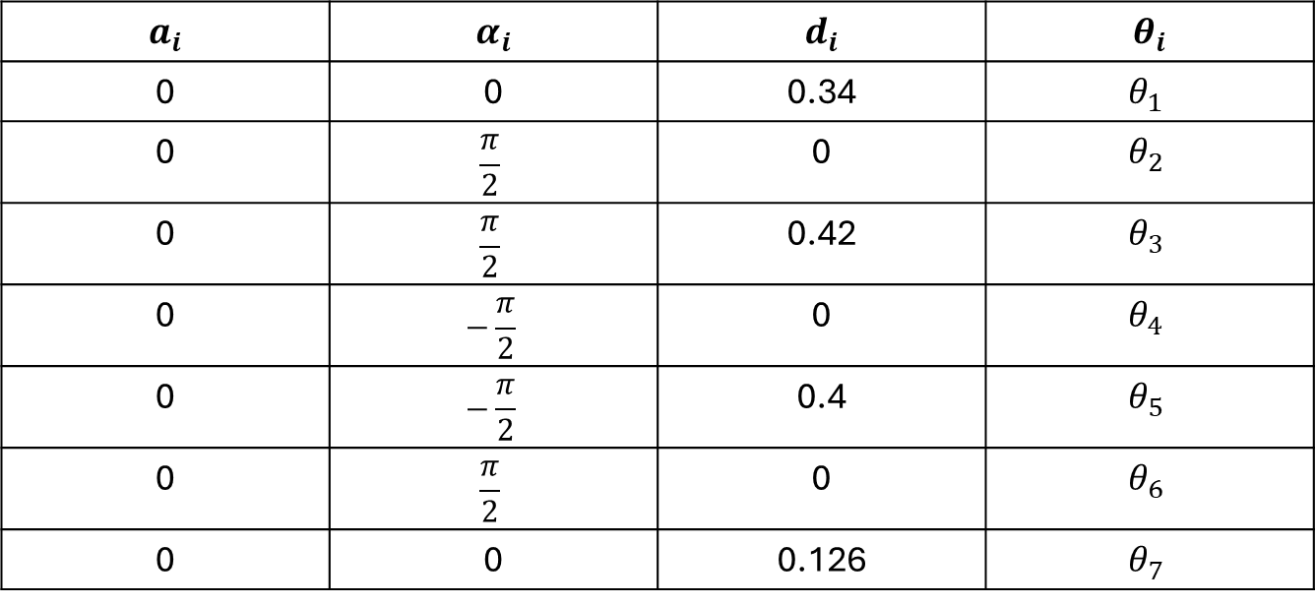
II. Main object
KUKA LBR iiwa 14 R820 is the 7-DoF manipulator
With the end effector $\left[P_{t} O_{t}\right]=\left[\begin{matrix}\begin{matrix}x & y & z\end{matrix} & \begin{matrix}θ_{x} & θ_{y} & θ_{z}\end{matrix}\end{matrix}\right]$ (6 states), it have infinite solution for 7 state joints.
D-H table:
$$a_{i}$$ | $$α_{i}$$ | $$d_{i}$$ | $$θ_{i}$$
0 | 0 | 0.34 | $$θ_{1}$$
0 | $$\frac{π}{2}$$ | 0 | $$θ_{2}$$
0 | $$\frac{π}{2}$$ | 0.42 | $$θ_{3}$$
0 | $$−\frac{π}{2}$$ | 0 | $$θ_{4}$$
0 | $$−\frac{π}{2}$$ | 0.4 | $$θ_{5}$$
0 | $$\frac{π}{2}$$ | 0 | $$θ_{6}$$
0 | 0 | 0.126 | $$θ_{7}$$
Forward kinematics: $FK\left(\left[\begin{matrix}P_{t} & O_{t}\end{matrix}\right]\right)=M_{1}M_{2}M_{3}M_{4}M_{5}M_{6}M_{7}$

Slide 4

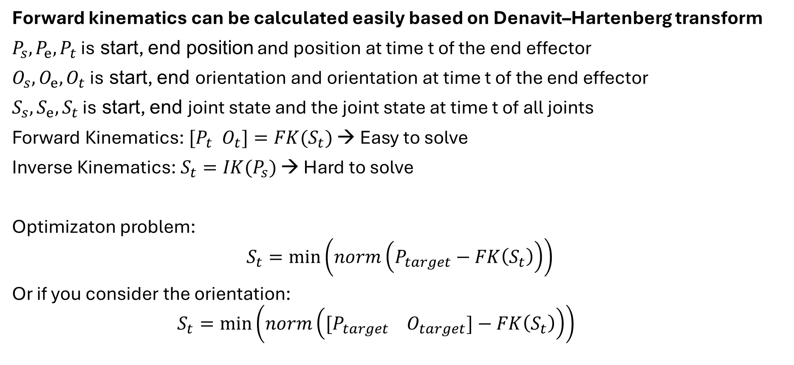
II. The Solution
Forward kinematics can be calculated easily based on Denavit–Hartenberg transform
$P_{s}, P_{e}, P_{t}$ is start, end position and position at time t of the end effector
$O_{s}, O_{e}, O_{t}$ is start, end orientation and orientation at time t of the end effector
$S_{s},S_{e},S_{t}$ is start, end joint state and the joint state at time t of all joints
Forward Kinematics: $[P_{t} O_{t}]=FK(S_{t})$ → Easy to solve
Inverse Kinematics: $S_{t}=IK(P_{s})$ → Hard to solve
Optimizaton problem:
$$S_{t}=\min\left(norm\left(P_{target}−FK\left(S_{t}\right)\right)\right)$$
Or if you consider the orientation:
$$S_{t}=\min\left(norm\left({[P}_{target}{ O}_{target}]−FK\left(S_{t}\right)\right)\right)$$
End effector
Joint
Base

Slide 5
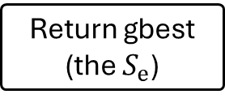
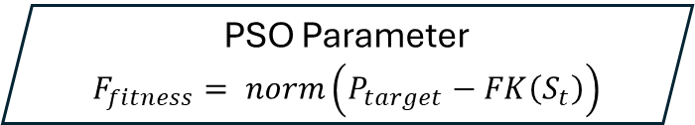
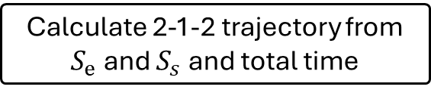
II. PSO-based Inverse Kinematics from start position to the end position
PSO Parameter
$F_{fitness}= norm\left(P_{target}−FK\left(S_{t}\right)\right)$
Generate initial Population
Calculate Fitness function for each particle
Enough iteration or precise
Yes
Return gbest (the $S_{e}$)
Calculate 2-1-2 trajectory from $S_{e}$ and $S_{s}$ and total time
No
Update personal best (pbest) and global best (gbest)
Apply to the model

Slide 6
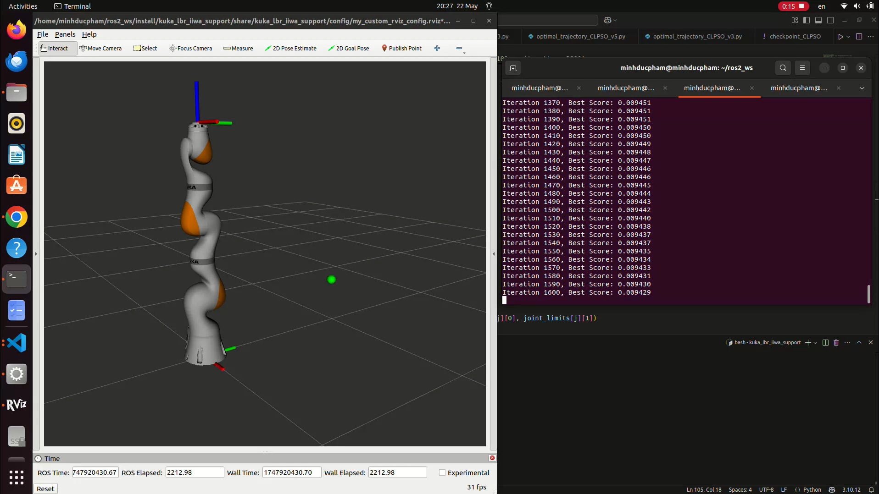
II. PSO-based Inverse Kinematics from start position to the end position

Slide 7
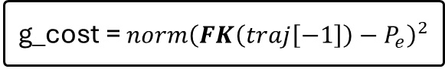
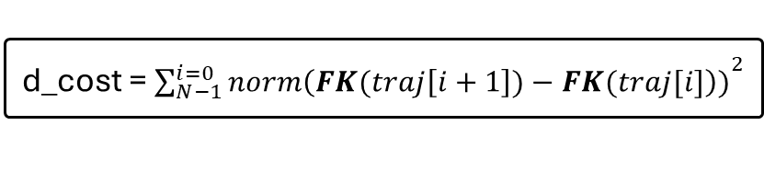
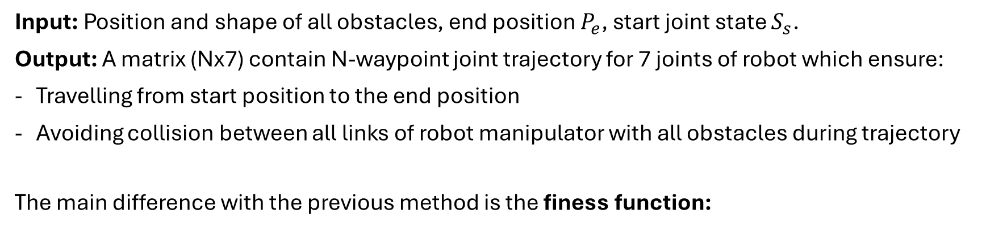
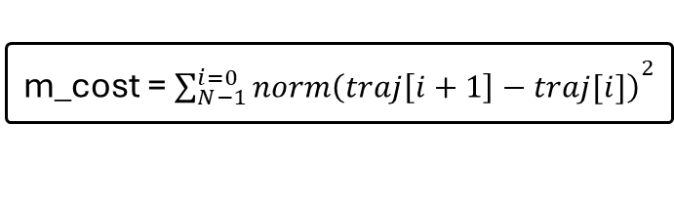
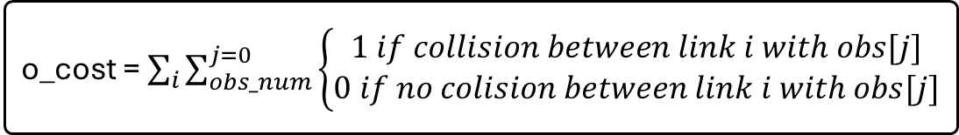
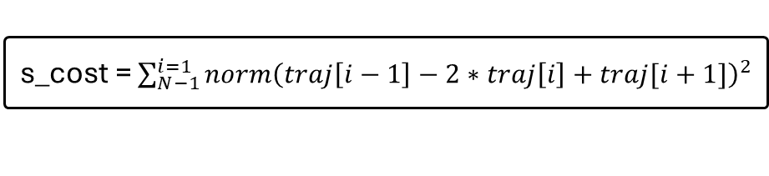
III. PSO-based obstacle avoidance algorithm for robot manipulator
Input: Position and shape of all obstacles, end position $P_{e}$, start joint state $S_{s}$.
Output: A matrix (Nx7) contain N-waypoint joint trajectory for 7 joints of robot which ensure:
Travelling from start position to the end position
Avoiding collision between all links of robot manipulator with all obstacles during trajectory
The main difference with the previous method is the finess function:
g_cost = ${norm\left(FK\left(traj\left[−1\right]\right)−P_{e}\right)}^{2}$
Goal_cost: end effector in the goal position
s_cost = $\sum_{N−1}^{i=1}{{norm\left(traj\left[i−1\right]−2∗traj\left[i\right]+traj[i+1]\right)}^{2}}$
Smooth_cost: Reduce acceleration of joint state
m_cost = ${\sum_{N−1}^{i=0}{norm\left(traj\left[i+1\right]−traj[i]\right)}}^{2}$
Movement_cost: Reduce total angle all joint have to move
d_cost = ${\sum_{N−1}^{i=0}{norm\left(FK(traj\left[i+1\right])−FK(traj[i]\right))}}^{2}$
Distance_cost: Reduce total distance end effector have to move
o_cost = $\sum_{i}{\sum_{obs_num}^{j=0}{\left\{\begin{aligned}1 if collision between link i with obs[j] \\ 0 if no colision between link i with obs[j]\end{aligned}\right.}}$
Obstacle_cost: Avoid all obstacle

Slide 8
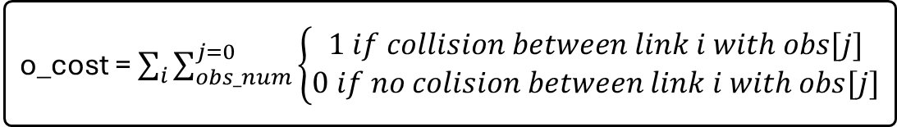
III. PSO-based obstacle avoidance algorithm for robot manipulator
About the Obstacles_cost:
o_cost = $\sum_{i}{\sum_{obs_num}^{j=0}{\left\{\begin{aligned}1 if collision between link i with obs[j] \\ 0 if no colision between link i with obs[j]\end{aligned}\right.}}$
Joint 6
Three link:
Link 1 connecting Joint 2 and Joint 4
Link 2 connecting Joint 4 and Joint 6
Link 3 connecting Joint 6 and Joint 7
Joint 4
Joint 7
Safe range
Obstacles_cost function ensure the link connected by 2 joints does not go through all defined obstacles
For simple, all obstacles used in this project is sphere obstacles.
Joint 2
Base

Slide 9
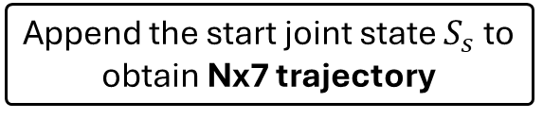
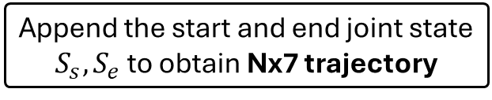
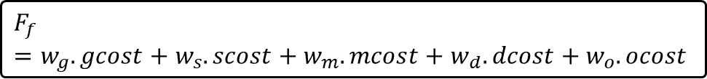
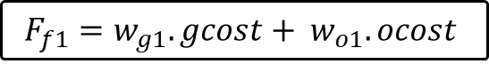
III. PSO-based obstacle avoidance algorithm for robot manipulator
Approach 1: One PSO Algorithm
Approach 2: Two PSO Algorithm
Particle represent (N-1)x7 array (don’t know the end joint state at first)
First PSO: Find the end joint position
Particle represent 1x7 array as the end joint state $S_{e}$
$$F_{f}=w_{g}.gcost+w_{s}.scost+w_{m}.mcost+w_{d}.dcost+w_{o}.ocost$$
$$F_{f1}=w_{g1}.gcost+ w_{o1}.ocost$$
Append the start joint state $S_{s}$ to obtain Nx7 trajectory
Second PSO: Find the trajectory
Particle represent (N-2)x7 array (not include both start and end joint state at first)
Initialize population (guide the particles between the start and goal in joint space)
Disadvantage:
Must use the random initial population → hard to converage to good result
More complicated fitness function
$$F_{f2}=w_{s}.scost+w_{m}.mcost+w_{d}.dcost+w_{o}.ocost$$
Append the start and end joint state $S_{s},S_{e}$ to obtain Nx7 trajectory

Slide 10
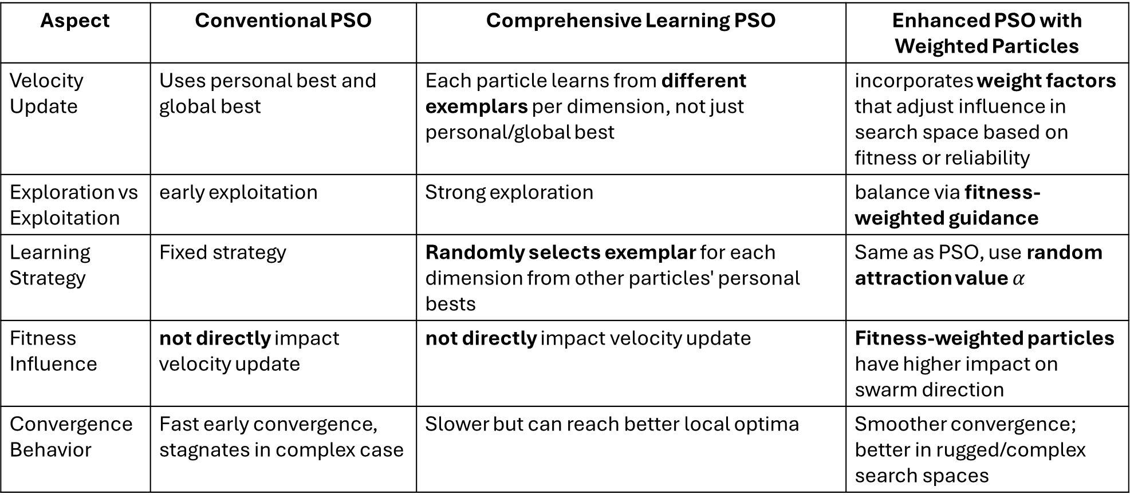
III. PSO-based obstacle avoidance algorithm for robot manipulator
Some PSO Algorithm are used:
Aspect | Conventional PSO | Comprehensive Learning PSO | Enhanced PSO with Weighted Particles
Velocity Update | Uses personal best​ and global best | Each particle learns from different exemplars per dimension, not just personal/global best | incorporates weight factors that adjust influence in search space based on fitness or reliability
Exploration vs Exploitation | early exploitation | Strong exploration | balance via fitness-weighted guidance
Learning Strategy | Fixed strategy | Randomly selects exemplar for each dimension from other particles' personal bests | Same as PSO, use random attraction value $α$
Fitness Influence | not directly impact velocity update | not directly impact velocity update | Fitness-weighted particles have higher impact on swarm direction
Convergence Behavior | Fast early convergence, stagnates in complex case | Slower but can reach better local optima | Smoother convergence; better in rugged/complex search spaces

Slide 11
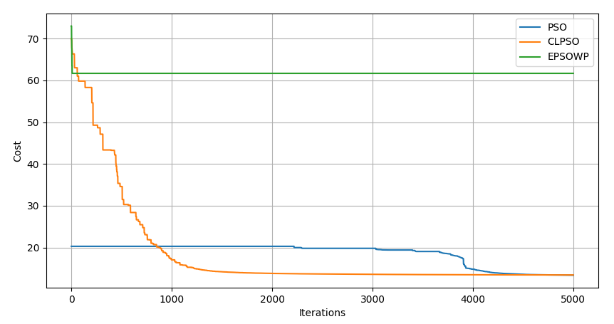
III. PSO-based obstacle avoidance algorithm for robot manipulator
Comparison between different PSO Algorithm:

Slide 12
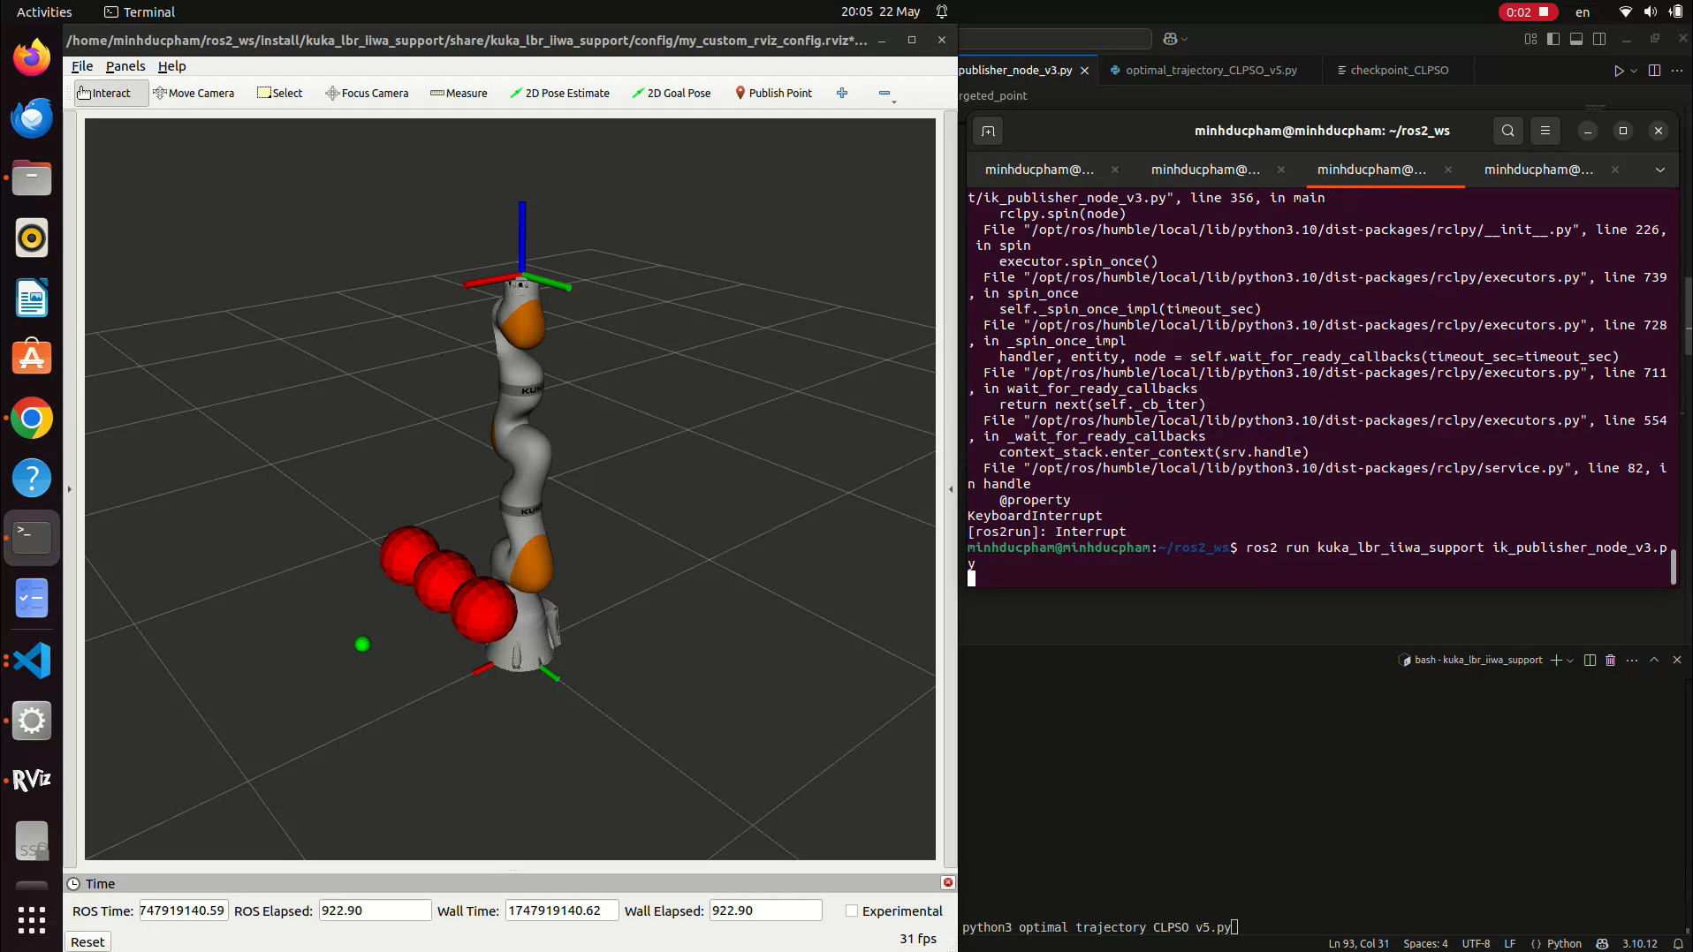
III. PSO-based obstacle avoidance algorithm for robot manipulator

Slide 13
THANKS FOR LISTENING !!

